Slide 1
Request interception for UI testing

Slide 2
Request interception for UI testing

Slide 3
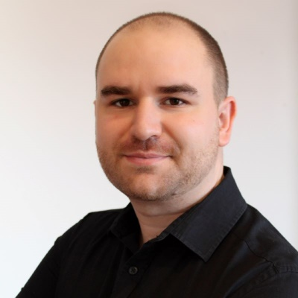
introduction
Sandor orosz
Lead Software Test Automation Engineer
8+ years in software testing
5+ years at EPAM
JS/TS
Community Manager of Idea Pool

Slide 4
introduction
John Doe
Senior Software Test Automation Engineer

Slide 5
introduction
John Doe
Senior Software Test Automation Engineer

Slide 6
introduction
John Doe
Senior Software Test Automation Engineer

Slide 7

agenda
1
Introduction
2
3
4
5
examples
6
Q&a

Slide 8

Agenda 1

Slide 9

intro

Slide 10
Ppt templates
Customized presentation templates to use the design language of the company
The brand colors of the company
Unified style
Easily adaptable
Easily recognizable

Slide 11

Questions

Slide 12
Thank you!

